Slide 1
GROUP 3 • CAPSTONE PROJECT
Telco Customer Churn Analysis
Service Analysis, Financial Impact & Retention Strategy
7,043 Customers Analyzed | 26.5% Churn Rate | $139.1K/mo Revenue Lost

Slide 2
THE BRIEF
What Stakeholders Asked Us to Find Out
Q1
Q2
Q3
Q4
“Where is the money actually going?”
“Who's leaving, and who's next?”
“Which services should we push harder?”
“Is it price, or is it us?”
Quantify revenue and lifetime value lost to churn.
Profile churn by contract and payment behaviour.
Prove which add-ons reduce churn risk.
Separate price-driven churn from service-driven churn.
Customer Churn Analysis | Group 3
2

Slide 3
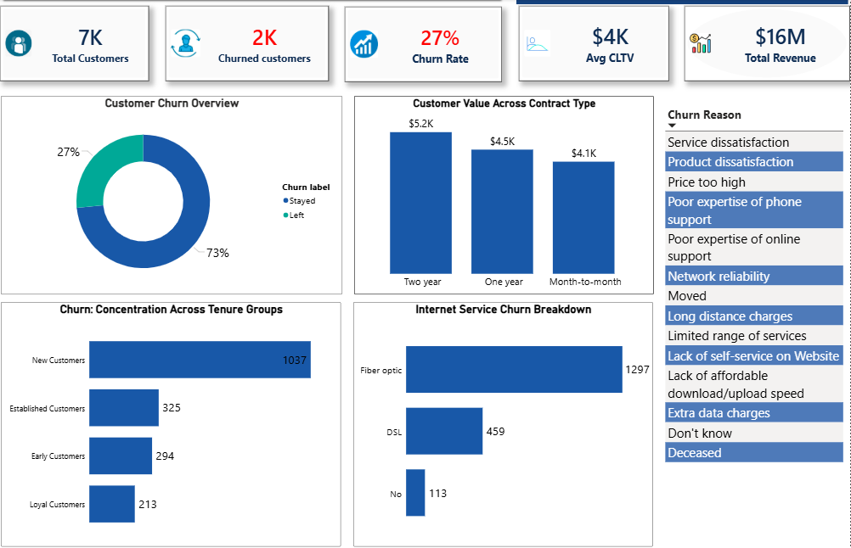
The Churn Story at a Glance
Customer Churn Analysis | Group 3
3

Slide 4
CUSTOMER BEHAVIOUR
Who's Leaving, and Why It's Predictable
2k
42.7%
INSIGHT
88.55% of churned customers were on month-to-month contracts, and 57.3% paid by Electronic Check. This shows that, short-term contracts and manual payment methods are the two strongest predictors of churn.
Churned Customers
Month-to-Month Churn Rate
RECOMMENDATION
Focus retention efforts on month-to-month customers and those using Electronic Check or Mailed Check, as they represent the highest churn risk. Encourage longer-term contracts through loyalty incentives and discounts, while promoting automatic payment methods, payment reminders, and targeted engagement campaigns to improve customer retention.
Customer Churn Analysis | Group 3
4

Slide 5
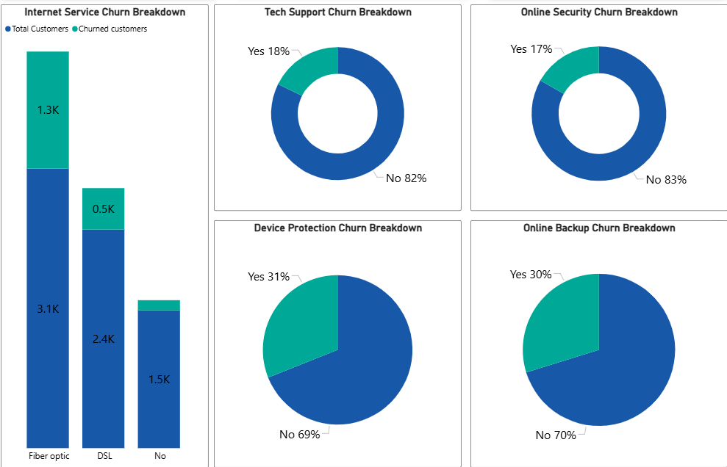
SERVICE ANALYSIS
What Keeps Customers Loyal
Customer Churn Analysis | Group 3
5

Slide 6
SERVICE ANALYSIS
What Keeps Customers Loyal
INSIGHT
Fiber optic customers are churning at more than twice the rate of DSL customers, and account for 69.4% of everyone who left despite fiber being the company's premium offering. This suggests that while fiber is the company's premium, higher-revenue offering, it is also its highest-risk segment likely driven by higher price points, elevated service expectations, and stronger competitive alternatives for high-speed internet.
Customers without online security make up 78.17% of all churned customers ( the largest single service gap in the data.)
RECOMMENDATION
Bundle Online Security, Tech Support and Backup as a default 'Protection Package' for fiber customers rather than opt-in extras as each add-on roughly halves churn risk.
Customer Churn Analysis | Group 3
5

Slide 7
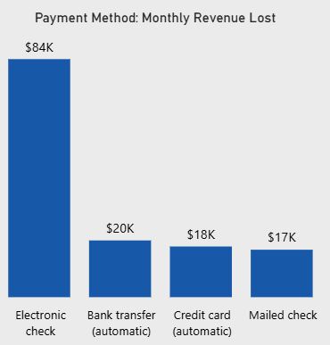
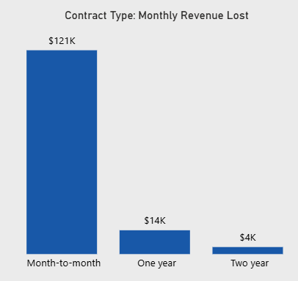
FINANCIAL IMPACT
What Churn Is Actually Costing Us
$16.06M
$139.1K
$2.86M
$4.4K
Total Revenue
Monthly Revenue Lost
Lifetime Revenue Lost
Avg. CLTV: Churned
Customer Churn Analysis | Group 3
6

Slide 8
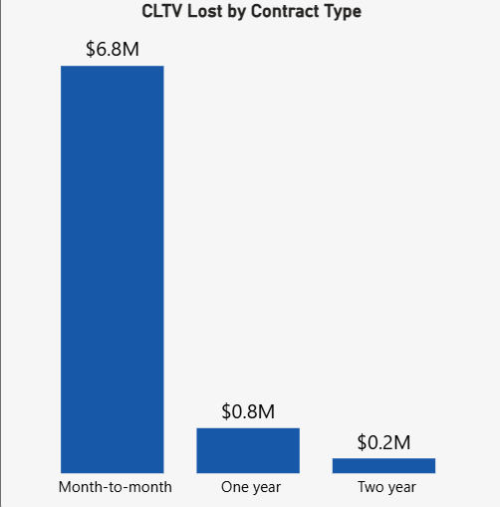
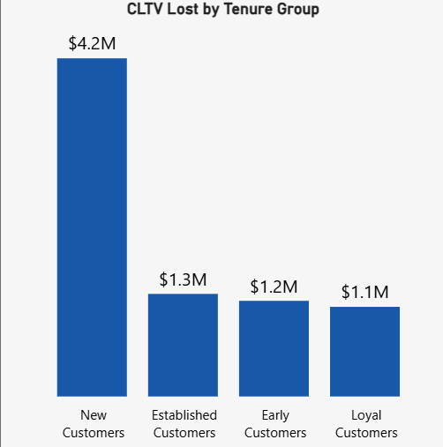
FINANCIAL IMPACT
What Churn Is Actually Costing Us
$16.06M
$139.1K
$8M
$4.4K
Total Revenue
Monthly Revenue Lost
Total CLTV Lost
Avg. CLTV: Churned
INSIGHT
Month-to-month contracts and Electronic Check payments each drive over half of monthly and lifetime losses, and new customers alone account for over half of all CLTV lost. The risk sits almost entirely in short-tenure, low-commitment customers.
RECOMMENDATION
Prioritize retention spend on new, month-to-month, Electronic Check customers as this single overlapping group carries the majority of both the ongoing monthly bleed and the long-term value at stake.
Customer Churn Analysis | Group 3
6

Slide 9
BUSINESS INSIGHT
Is It Price, or Is It Us?
Top Individual Reasons
Attitude of support person
192
Competitor offered higher download speeds
189
Competitor offered more data
162
Others
154
Competitor made better offer
140
Service and support quality (37.9%) is the single largest driver of stated churn ahead of competitor offers (33.2%) and price (8.3%). This is a service problem more than a price problem.
Customer Churn Analysis | Group 3
7

Slide 10
RECOMMENDATIONS
Three Moves That Matter Most
1
2
3
Convert month-to-month customers
Migrate customers to autopay
Bundle protection services
Discounted annual/2-yr plans and loyalty perks to reduce the segment driving 88% of churn.
Incentivize bank transfer / credit card autopay to cut churn risk.
Default Online Security, Tech Support and Backup into fiber plans to roughly halve churn risk.
Customer Churn Analysis | Group 3
9

Slide 11
Thank You
Questions & Discussion
Group 3 | Customer Churn Analysis

